Slide 1
SOFTWARE DEVELOPMENT 3
File I/O in Java(2)

Slide 2
Writing to a Text File
You have used a combination of classes to read text files:
  File
  BufferedReader
  FileReader
  Scanner (read from a file only)
We learned that the Scanner class is easier to use than BufferedReader and FileReader as there isn’t any need to parse the data into relevant data types.

Slide 3
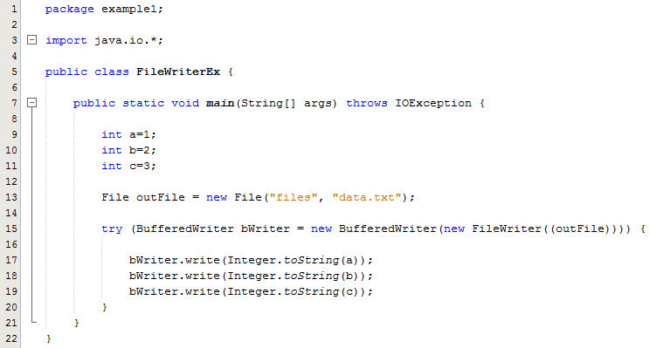
Writing to a Text File
FileWriter has a very limited set of methods for writing data to a text file.
Again we needed to convert the data into String format before calling the write method to write the data to the file
Lines 17-19:
Integers need to be converted to String format before writing to the file

Slide 4
Writing to a Text File
A better alternative for writing data is to use a class called PrintWriter
A stream of the class PrintWriter is created and connected to a text file for writing as follows:
    PrintWriter out = new PrintWriter(
    new BufferedWriter(
    new FileWriter(FileName)))

Slide 5
Writing to a Text File
This produces an object of the class PrintWriter that is connected to the file FileName
  The process of connecting a stream to a file is called opening the file
  If the file already exists, then doing this causes the old contents to be lost
  If the file does not exist, then a new, empty file named FileName is created
After doing this, the methods print and println can be used to write to the file

Slide 6
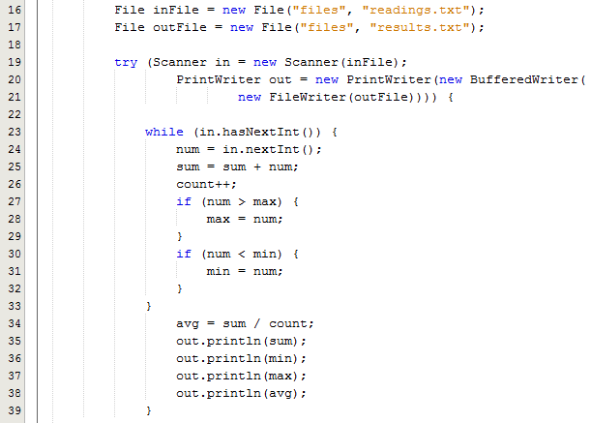
Writing to a Text File - Example
The PrintWriter class enables you to write formatted data to an underlying Writer. For instance, writing int,long and other primtive data formatted as text, rather than as their byte values.
The PrintWriter class contains the useful format() and printf() methods
The PrintWriter has a wide selection of contructors that enable you to connect it to a File, an OutputStream, or a Writer.

